Slide 1
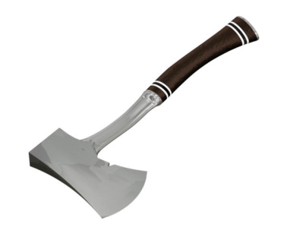
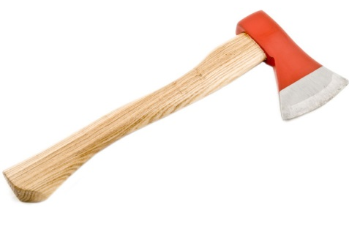
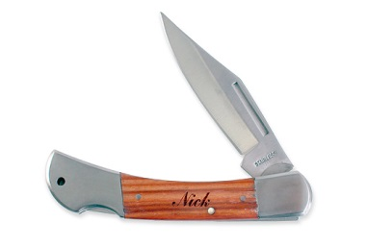
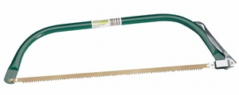
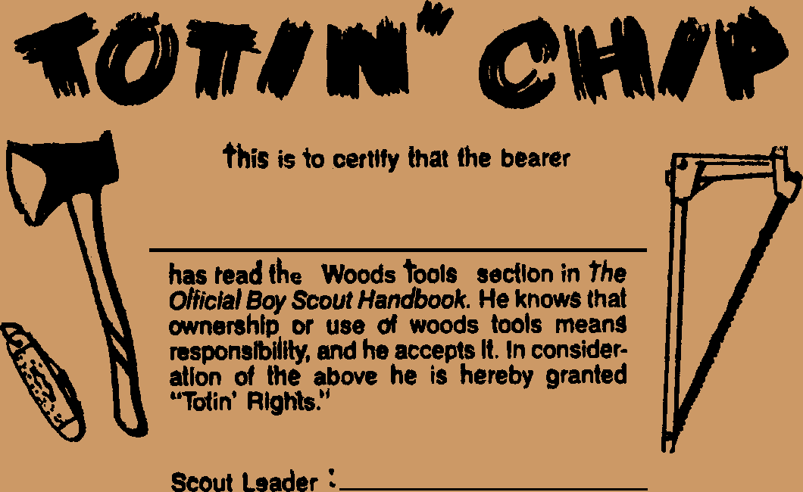
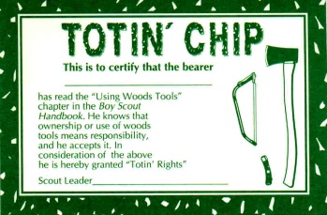
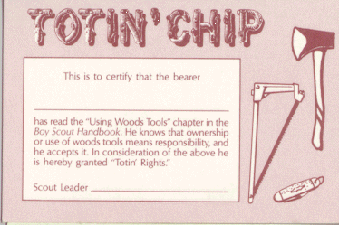
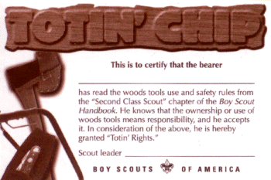
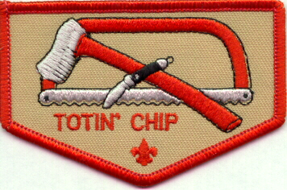
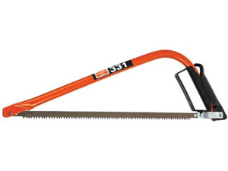
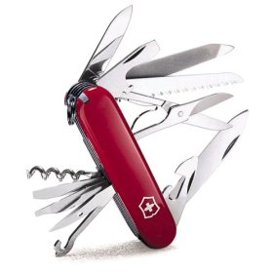
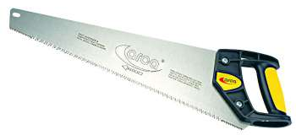
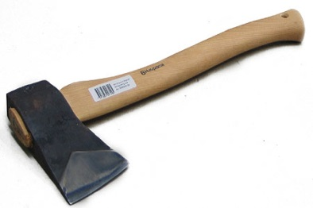
Totin’Chip

Slide 2
Key word: SAFETY!!
BE PREPARED!!
Always have an axe yard
  Safe area separated from other people
Always think about what might go wrong
  Stand away from the axes and saws
  Don’t stand in line with the axes
  Safety circle (blood circle)
Think!! Don’t do something stupid

Slide 3
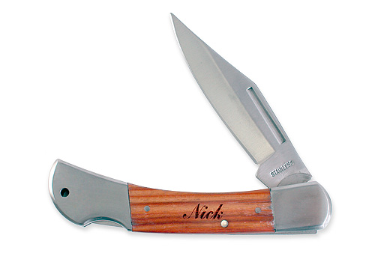
Knives
Acceptable Knives: folding, no longer than 3 ¼ inch blade
Do:
Keep the blades closed except when you are using them
Cut away from yourself
Keep your knife sharp and clean. A sharp blade is easier to control than a dull one; a clean blade will last longer.
Close the blades before you pass a knife to someone
Establish a circle of safety
Establish confirmation when passing a knife (Thank you I got it)

Slide 4
Knives
Don’t
Carry a knife with the blade open
Cut toward yourself. If the blade slips, you may be injured.
Pound on a knife handle or blade with another tool. The knife may break.
Throw a knife
Pry with the point of a cutting blade. It can snap off.
Put a knife in a fire. New knife blades are hardened, or tempered, with just the right amount of heat. Reheating them may ruin the temper and weaken the knife.
Cross your body when passing a knife.

Slide 5
Saws
Saw teeth are needle-sharp. Treat every saw with the same respect you give your pocketknife. Close folding saws when they aren't in use and store them in a tent or under the dining fly. Protect the blade of a bow saw with a sheath made from a piece of old garden hose the length of the blade or established sheath. Slit the hose down on one side, slip it over the blade, and hold it in place with duct tape or cord. You can carry a folded camp saw inside your pack. With its sheath covering the blade, tie a bow saw flat against the outside of your pack.

Slide 6
Saws
Camp Saw
A camp saw is the right tool for most outdoor woodcutting. The blades of folding saws close into their handles, much like the blades of pocketknives. Bow saws have curved metal frames that hold their blades in place.
Using a Camp Saw
- Establish an ax yard or circle of safety.
- Brace the wood to be cut against a solid support. Use long, smooth strokes that let the weight of the saw pull the blade into the wood.
- When sawing a dead branch from a tree, make an undercut first, then saw from the top down. The undercut prevents the falling branch from stripping bark and wood from the trunk. Make a clean cut close to the trunk so you don't leave an unsightly "hat rack". Cut saplings level with the ground so there's no stumps for someone to trip over.
- Because of its size and the way in which it is used, an ax can be more dangerous than other wood tools. Remove the sheath only when you are prepared to use your ax correctly. Give it your full attention.

Slide 7


Axes
Safe tool
An ax must be sharp and in top condition. If the head is loose, soak the ax for a few hours in a stream or a bucket of Linseed oil. The wood in the head will swell, and the handle will be tight for a while. Linseed Oil or Flax Seed Oil doesn't dry out as quickly as water, thus making it safer. When you are home, drive a wedge into the wood in the head, or replace the worn handle with a new one.

Slide 8
Axes
Safe shoes
Always wear sturdy leather boots when you are chopping with an ax. Leather won't stop a blade from hitting your foot, but good boots may limit the extent of an injury.
Safe carrying
Place a sheath over an ax blade whenever it is not in use. Carry an ax at your side with one hand, the blade turned out from your body. If you stumble, toss the ax away from you as you fall. Never carry an ax over your shoulder.

Slide 9
Axes
Safe storage
Sheathe your ax and store it under the dining fly or in a tent. On the trail, a sheathed ax can be tied or strapped to the outside of your pack.
Safe handling
To pass an ax to another person, hold the handle near the knob with the head down. Pass the ax with the bit facing out at right angles between you and the other person. When your partner has a grip on the handle, he should say, "Thank you." That's your signal to release your hold.

Slide 10
Axes
Safe working area
You must have plenty of room in which to swing an ax. Check your clearance by holding your ax by the head. Slowly swing the handle at arm's length all around you and over your head. Remove any brush or branches that the handle touches. While you are cutting, be certain other people stay at least 10 feet away.
In a long-term camp using lots of firewood, rope off an ax yard large enough to provide the clearance you need to work. Enter the yard only to chop and saw wood. Allow just one person at a time in the ax yard. Clean up the chips, bark, and other debris of cutting.

Slide 11
Axes
Safe technique
Chopping branches off a downed log is called limbing. Stand on the right side of the log opposite a branch. Chop close to the base of the branch, driving the ax into the underside of the limb. Keep the log between you and your cuts. If the ax misses a branch, the blade will hit the log rather than your leg.
Bucking a log means cutting through it. Stand beside the log with your feet shoulders'-width apart. Hold the ax with one hand near the head and then slide your hands together as you swing the bit into the log. Let the falling weight of the ax do most of the work. Slide your hand back down the handle to the head. Lift it and swing again. Aim your strokes so that you cut a V shaped notch twice as wide at the top as the log is thick.

Slide 12

Axes
Learn to switch-hit with your ax. As you cut on the right side of a notch let you right hand slide on the ax handle. Switch your grip and slide your left hand up the handle as you work from the left side of a notch. Develop a relaxing easy rhythm, switching hands after each blow.
Cutting small sticks and splitting large chunks of wood known as rounds are best done on a chopping block, which is a piece of log that has been sawed and turned upright to provide a flat surface. It should be about 2 feet high so that you won't have to lean down much as you work. A chopping block is important for safety too. If you swing your ax badly, the bit will probably hit the block instead of flying on toward your feet.
To split a large round of wood, stand it upright on a chopping block. Swing the ax as you would to buck a log, driving the bit into the end of the round. If the wood doesn't split, remove the ax before swinging it again. Do not swing an ax with a piece of wood wedged on the bit.

Slide 13
This certification grants a Scout the right to carry and use woods tools. The Scout must show his Scout leader, or someone designated by his leader, that he understands his responsibility to do the following:
Read and understand woods tools use and safety rules from the Boy Scout Handbook.
Demonstrate proper handling, care, and use of the pocket knife, ax, and saw.
Use knife, ax, and saw as tools, not playthings.
Respect all safety rules to protect others.
Respect property. Cut living and dead trees only with permission and good reason.
Subscribe to the Outdoor Code.
The Scout's "Totin' Rights" can be taken from him if he fails in his responsibility.

